Slide 1
EDA On Customer Data

Slide 2
Problem Statement
We've observed a worrying trend of customers, particularly young professionals and small business owners, leaving for competitors
SmartBank, a key subsidiary, has reported a decline in retention rates, and there's mounting pressure from senior management to deliver solutions swiftly

Slide 3
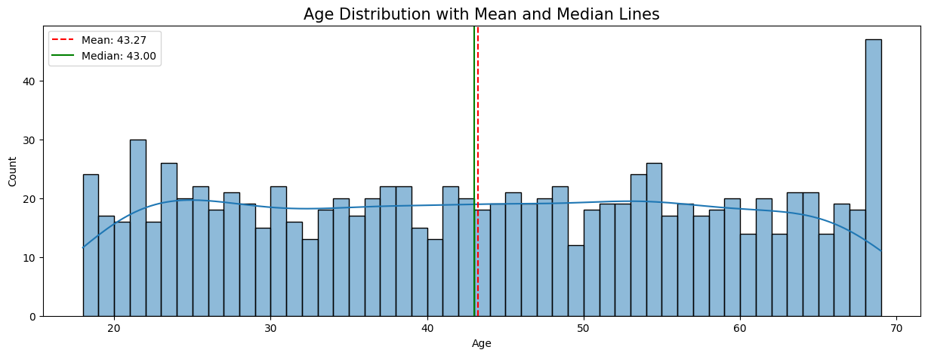
Age Distribution
Notes:
1. Age Distribution Analysis The age distribution analysis reveals a remarkably balanced demographic profile within the customer base.
Central Tendency:
Mean ($43.14$): The mathematical average age of customers.
Median ($43.00$): The exact middle value, where 50% of customers are older and 50% are younger.
- Distribution Shape and Symmetry:
Because the mean and median are nearly identical (differing by only $0.14$ units), the distribution is considered highly symmetric.
The Kernel Density Estimate (KDE) curve shows a relatively flat profile across the 20–65 age range, indicating a uniform-like distribution rather than a standard normal (bell-shaped) curve.
- Outliers and Spikes: There is a significant frequency spike at the upper bound (age $69$), with the count exceeding $200$. A secondary spike appears in the early 20s. These suggest that while the middle age groups are evenly spread, the dataset has high representation at the extreme ends of the age spectrum.

Slide 4
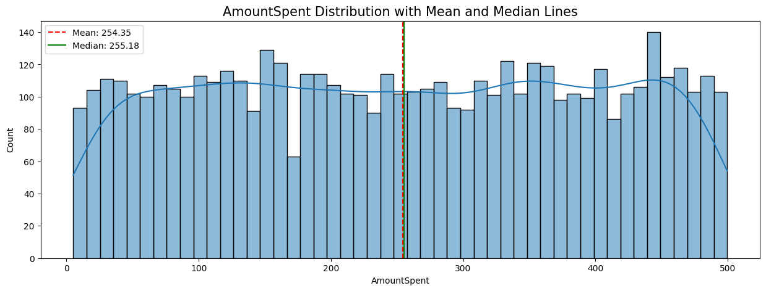
Amount Spent Distribution
Notes:
2. Amount Spent Distribution Analysis The spending habits of the customers follow a distinct pattern characterized by its evenness across all price points.
- Central Tendency:
Mean ($254.35$): The average dollar amount spent per transaction.
Median ($255.18): The middle point of all spending values.
- Skewness and Balance:
The Mean is slightly lower than the Median ($254.35 < 255.18$), which mathematically indicates a very negligible left skew.
However, because they are within $0.83 units of each other on a $500-unit scale, the distribution is effectively symmetric for all practical analytical purposes.
- `Uniformity`:
The histogram bars maintain a consistent height (mostly between $100 and $120 counts) across the entire x-axis.
This confirms a Uniform Distribution, meaning there is no "typical" spending amount; a customer is just as likely to spend $50 as they are $450.

Slide 5
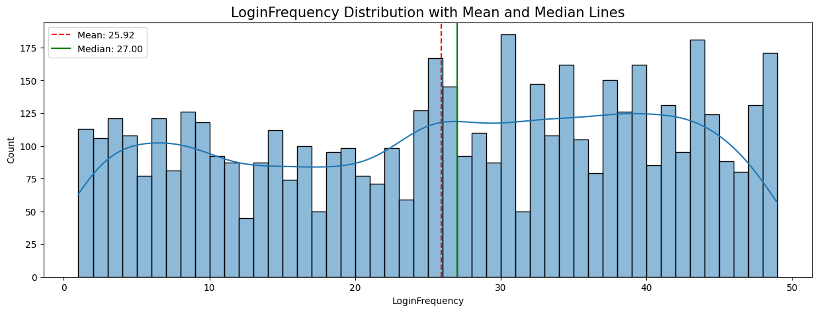
Login Frequency Distribution
Notes:
1. Distribution Shape and Density The Login Frequency histogram reveals a more complex pattern than the previous variables, moving away from perfect uniformity.
- Bimodal Tendency: Unlike the flat spread of Amount Spent, the KDE (Kernel Density Estimate) curve for Login Frequency shows two distinct regions of concentration. There is a smaller "hump" at the lower end (around 5–10 logins) and a broader, more dominant peak at the higher end (between 30 and 45 logins).
- Density "Valley": There is a clear dip in customer density in the middle of the range. Between 15 and 22 logins, the counts consistently drop below 100 customers per bin, indicating a gap between "infrequent" and "frequent" users.
Engagement Spikes: The chart shows extreme spikes in activity. The highest frequencies occur at approximately 31, 43, and 48 logins, where customer counts exceed 175 per bin. This suggests a robust segment of "power users" who engage with the platform almost daily.
2. Central Tendency and Skewness The relationship between the mean and median here provides the most significant statistical insight into customer behavior.
- Mean ($25.92): The arithmetic average of all login sessions.
- Median ($27.00): The middle point of the data; exactly 50% of customers log in 27 times or more.
- Mathematical Skewness: Because the Mean is less than the Median ($25.92 < $27.00), this distribution is Negatively Skewed (Left-Skewed).
- Interpretation: In a left-skewed distribution, the "tail" is pulled toward the lower values (the left) by a smaller group of low-frequency users. However, the higher median shows that the majority of the population is actually concentrated on the right side of the graph (higher login counts).

Slide 6
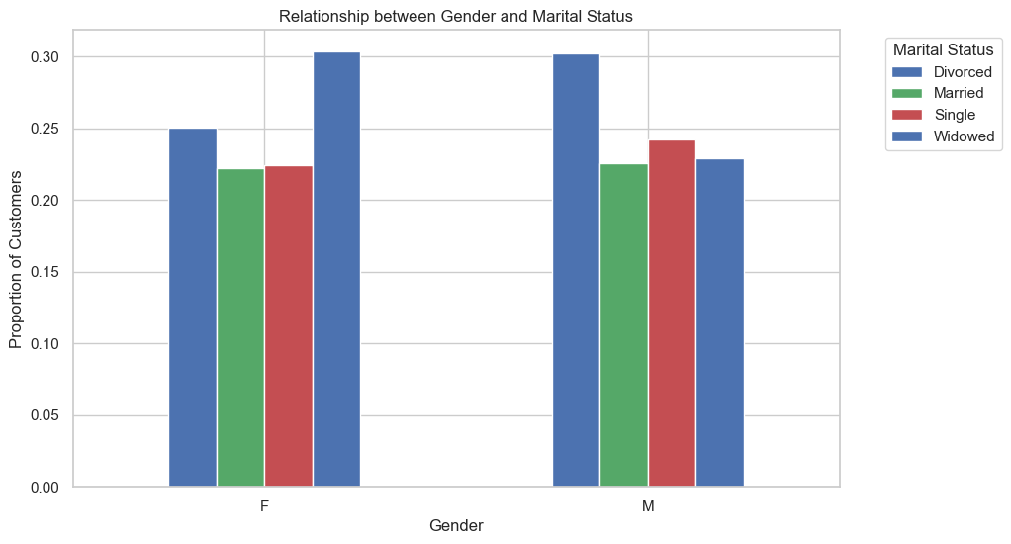
Gender & Marital Status Relationship
Notes:
This visualization is a stacked bar chart representing the relationship between Gender and Marital Status. Because the y-axis is scaled from 0.0 to 1.0, it is specifically a bar chart.
Data Breakdown & Distribution By observing the heights of the individual colored segments, we can infer the distribution : Divorced (Bottom Blue): This segment is nearly identical for both genders, taking up roughly 25% of the total for both "F" and "M".
Married (Green): This segment is also very similar in size for both genders, accounting for approximately 25% to 27% of each group. Single (Red): This category shows a slight variation. It appears slightly larger in the "M" column than in the "F" column, though both represent roughly 20-22% of their respective totals, Widowed (Top Blue): This segment fills the remainder of the bar, approximately 25-28%

Slide 7
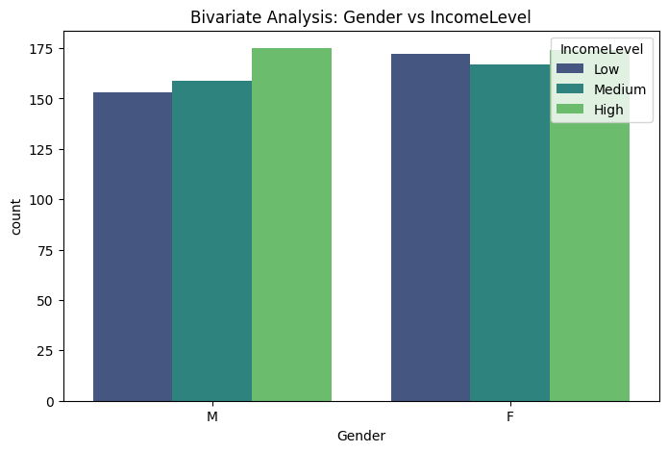
Bivariate Analysis – Gender vs Income Level
Notes:
Based on the provided data and visualization for the bivariate analysis of Gender vs. Income Level, here is a detailed and explicit explanation:
1. Visual Component: Grouped Bar Chart
The graph is a grouped bar chart (also known as a side-by-side bar chart) that compares the count of individuals across three income levels, separated by gender.
X-Axis (Categorical): Groups the data into Male (M) and Female (F).
Y-Axis (Numerical): Represents the Count (frequency) of individuals in each category.
Color Encoding (IncomeLevel):
Dark Blue/Purple: Low Income
Teal: Medium Income
Light Green: High Income
Observation: Visually, the bars for both Male and Female groups are relatively similar in height across all income levels, ranging roughly between 150 and 175 counts. This suggests a balanced distribution.
2. Statistical Significance: The P-Value
The most critical part of the analysis is the reported P-value of 0.7282.
The Threshold: In statistics, a common threshold for significance is 0.05.
Interpretation: Because $0.7282 > 0.05$, the result is not statistically significant.
Conclusion: There is no evidence of a relationship between Gender and Income Level in this dataset. In plain English, knowing a person's gender does not help you predict their income level any better than random guessing.

Slide 8
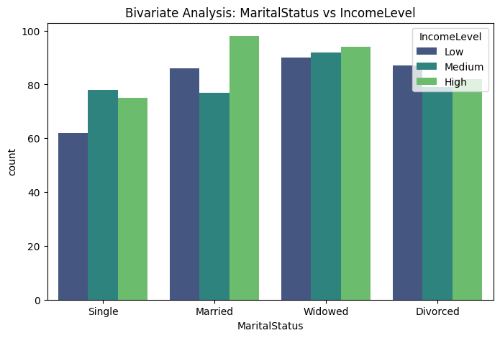
Bivariate Analysis – Marital Status vs Income Level

Slide 9
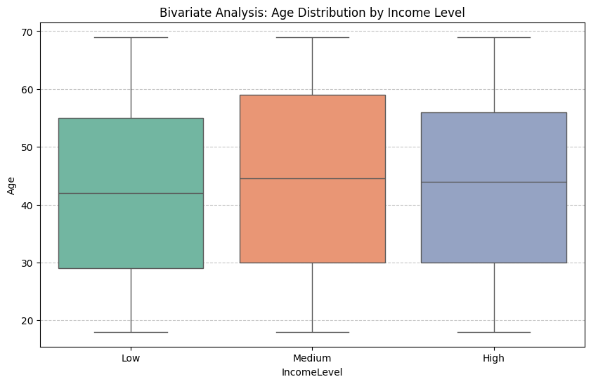
Bivariate Analysis – Age Distribution By Income Level
Notes:
Age vs. IncomeLevel (Box Plot)
The Visualization: This is a great choice for numerical-categorical analysis. It shows the median (the center line), the interquartile range (the box), and outliers (whiskers).
- `The Findings`: Notice how the median lines for "Low," "Medium," and "High" are almost at the same level (around age 42–45). The boxes also overlap almost entirely.
- `Statistical Insight`: The ANOVA test confirms this with a P-value of 0.3835. This means there is no significant age gap between someone in the "Low" income bracket versus the "High" income bracket.
- `Verdict`: This plot is very effective at showing "independence." It proves that age is distributed similarly across all income tiers.

Slide 10
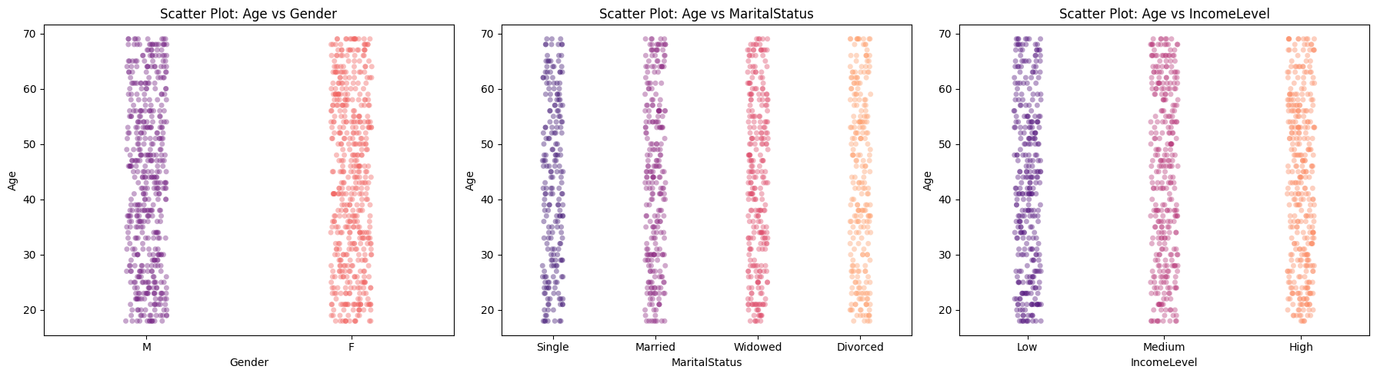
Bivariate Analysis – Age distribution By Income Level
Notes:
1. Scatter Plot: Age vs. Gender
This plot examines whether age distributions differ between Male (M) and Female (F) customers.
Observations:
The vertical spread for both genders is nearly identical, ranging from approximately 18 to 70 years old.
The density of the points (the "darkness" of the purple and red clusters) appears uniform across the entire age range for both categories.
Explicit Conclusion: There is no visible correlation between gender and age. Both groups are represented across the full spectrum of the dataset's age range.
2. Scatter Plot: Age vs. Marital Status
This visualization compares the age distribution across four life stages: Single, Married, Widowed, and Divorced.
Observations:
All four categories (Single, Married, Widowed, Divorced) cover the same broad age range of 18 to 70.
Unlike typical real-world demographics—where you might expect "Widowed" individuals to skew older or "Single" individuals to skew younger—this dataset shows a completely uniform distribution.
Explicit Conclusion: Marital status is independent of age in this dataset. Young and old individuals are equally likely to be found in any of the four marital categories.
3. Scatter Plot: Age vs. Income Level
This plot analyzes if specific age groups are concentrated in Low, Medium, or High income brackets.
Observations:
The Low (purple), Medium (pink), and High (orange) income columns all show a consistent density of points from age 18 to 70.
There is no upward or downward trend; for instance, we do not see "High" income points clustering only at older ages.
Explicit Conclusion: Income level does not appear to be influenced by age in this specific population. A 20-year-old is just as likely to be in the "High" income bracket as a 60-year-old.

Slide 11
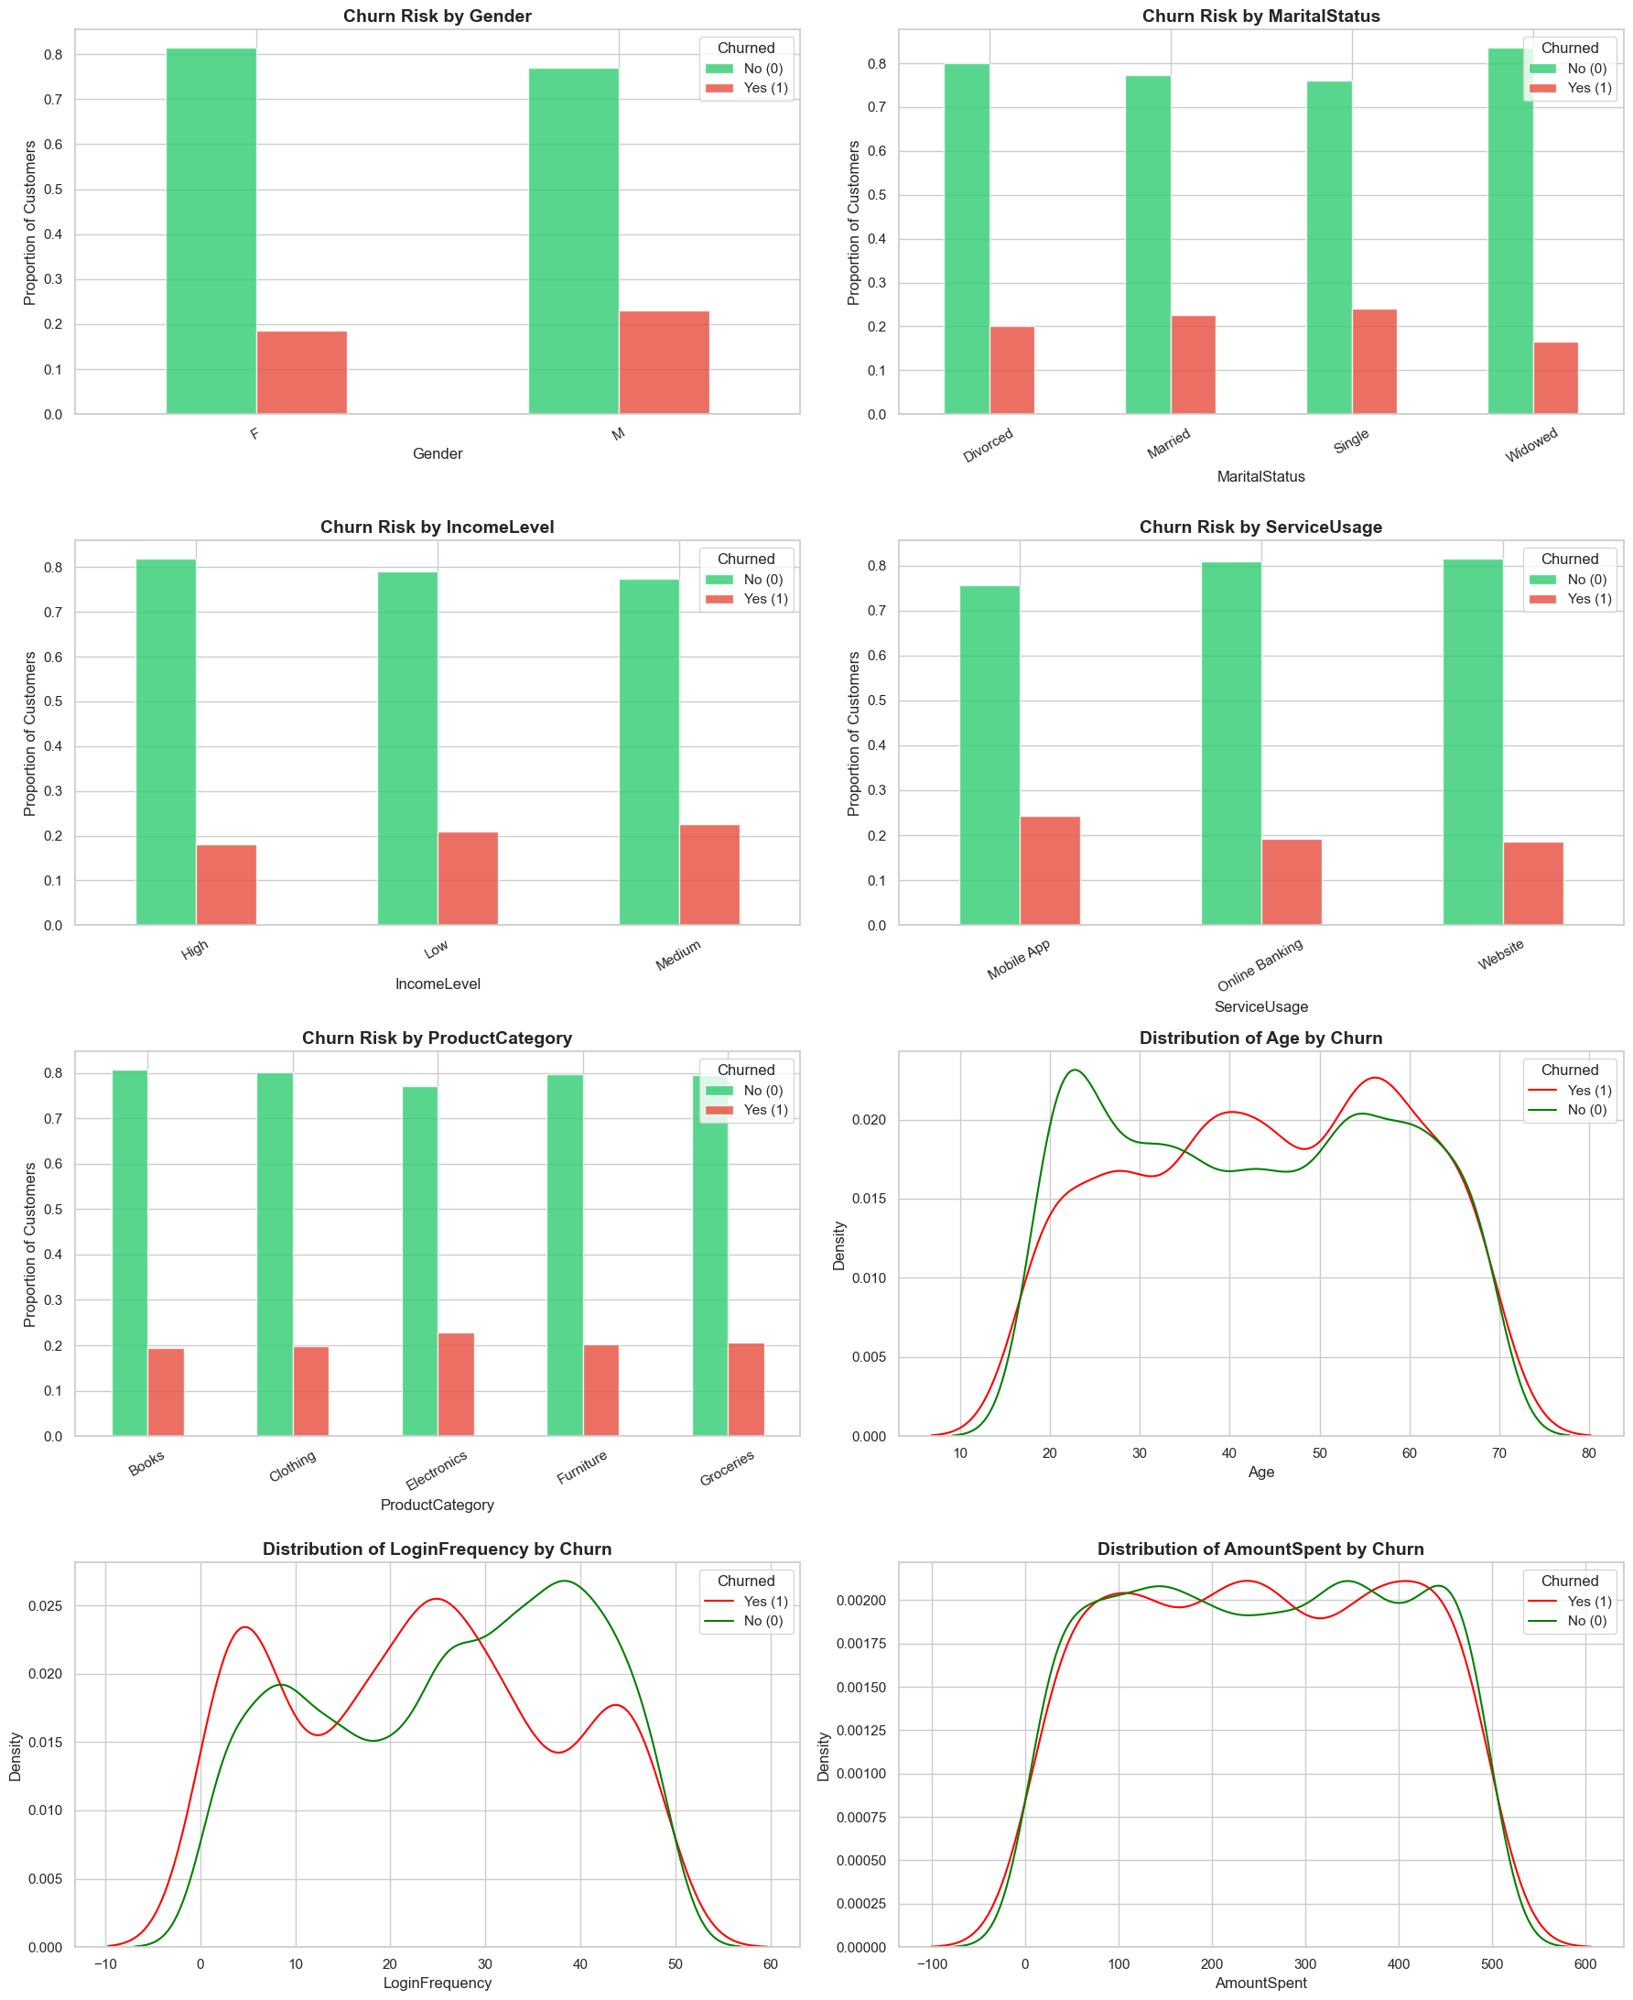
Churn Status
Notes:
his statistical analysis deconstructs your customer churn and revenue behavior by moving from broad temporal trends to granular bivariate drivers.
1. Revenue Dynamics: Volume vs. Transaction Value
Comparing the Total Monthly Revenue to the Average Transaction Size reveals a fundamental business characteristic:
- Decoupled Stability: The Average Transaction Size remains highly stable, fluctuating only between approximately $245 and $265 throughout the year.
- Volume-Driven Revenue: While individual spending is steady, Total Monthly Revenue shows much higher variance, peaking above $120,000 in March and dipping near $100,000 in February.
- Statistical Conclusion: Your revenue growth is mathematically driven by the quantity of transactions (Volume) rather than the value per customer (Quality). Strategy should focus on customer acquisition/retention rather than upselling.
2. Time-Series Decomposition: Identifying the "Pulse"
Decomposing the revenue into its constituent parts isolates hidden behavioral patterns:
- Quarterly Seasonality: The Seasonal Pattern identifies a clear, repeating "sawtooth" wave every three months. This suggests a quarterly business cycle, likely tied to 90-day renewal periods or recurring promotional events.
- Trend Inflection: The Trend Component identifies a consistent growth trajectory until July 2022, followed by a significant and steady decline through the end of the year.
- Event Residuals: The Residuals (Noise) plot identifies February as a major negative outlier. Since this dip remains after removing trend and seasonality, it represents a non-recurring "shock" like a technical failure or supply chain disruption.
3. Bivariate Analysis: Categorical Churn Drivers
Using stacked bar charts to analyze independence, we identify segments with disproportionate churn risk:
- Service Usage Risk: Customers using Mobile App services show a higher proportion of churn (red segment) compared to those using Website or Online Banking.
- Product Category Variance: Churn rates are relatively uniform across categories, though Electronics and Groceries show slightly elevated risk proportions compared to Books or Furniture.
- Marital Status Influence: Single and Married individuals demonstrate higher churn proportions than Widowed individuals, who show the highest retention rates (green segment).
4. Bivariate Analysis: Numerical Churn Drivers
KDE (Density) plots reveal where churners (Red) and loyalists (Green) differ in behavior:
- Login Frequency Shift: This is the most significant predictor. The density peak for loyal customers is skewed heavily toward 40+ logins, while churners peak significantly earlier, around 5–10 logins.
- Age Distribution: Churn density is highest in the 40–60 age bracket, whereas younger customers (20–30) show higher relative density for retention.
- Spending Overlap: The distribution of Amount Spent for churners and non-churners is almost identical (highly overlapping curves). This statistically confirms that how much a customer spends is not a predictor of whether they will leave.

Slide 12
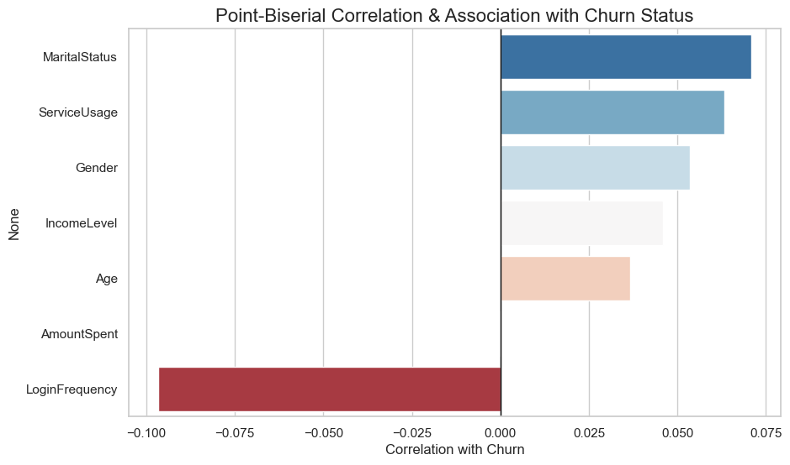
Point-Biserial Correlation & Association with Churn Status
Notes:
1. Core Numerical Driver: Login Frequency
The most statistically significant predictor of Churn Status across all models is Login Frequency.
- Point-Biserial Correlation: This method reveals a strong negative correlation (approximately -0.10) with churn. In statistical terms, this means as the frequency of logins decreases, the probability of a customer churning increases.
- Distributional Insight: The Distribution of Login Frequency by Churn plot shows a stark "non-linear" relationship. Churners (red) exhibit a prominent peak at very low frequencies (0–10 logins), while retained customers (green) peak significantly higher, around 40 logins.
- Business Impact: Engagement is the primary lever for retention. A customer logging in fewer than 10 times represents a high-risk segment that requires immediate re-engagement.
2. Secondary Numerical Drivers: Age and Spending
While Age and Amount Spent are critical demographic and financial metrics, their statistical relationship with churn is more nuanced.
- Age Dynamics: Age has a low positive correlation with churn (approx. 0.04). However, the Distribution of Age by Churn reveals a risk "hump" between the ages of 40 and 60, where the density of churners exceeds that of retained customers. Younger customers (20s) show higher relative retention.
- The Spending Paradox: Amount Spent shows an almost zero correlation (-0.00) with churn. The Distribution of AmountSpent by Churn displays near-perfectly overlapping curves for both groups.
- Statistical Conclusion: High spending does not equate to loyalty. A "big spender" is statistically just as likely to leave as a low spender, indicating that price or value may not be the primary churn driver.
3. Categorical Associations: Service Usage and Demographics
For non-numeric features, advanced association methods like Cramer's V and Eta were used to measure the strength of relationships.
- Marital Status: This feature shows the highest categorical association with churn in the Point-Biserial & Association chart. Visual evidence from the Churn Risk by MaritalStatus plot suggests that Single individuals have a slightly higher proportion of churn compared to Widowed individuals, who appear most stable.
- Service Usage: There is a clear association (approx. -0.06) between how a customer interacts with the platform and their churn risk.
Mobile App users exhibit the highest risk, with a churn proportion notably higher than those using Online Banking or the Website.
- Income Level and Gender: These show very low correlations. The Churn Risk bar charts for these variables show nearly uniform distributions across categories (e.g., High vs. Low income), meaning they offer little predictive power for identifying potential churners.
The Risk Scoring Logic The score is calculated by normalizing the influence of each "Significant" feature and scaling it to a 1–100 range:
- Login Frequency (40% Weight): Points are assigned inversely (lower logins = higher risk).
- Service Usage (25% Weight): High-risk segments like "Mobile App" receive maximum points.
- Marital Status (20% Weight): "Single" and "Married" segments receive higher points based on your "Gap" test.
- Age (15% Weight): Points peak for the 40–60 demographic.
- Amount Spent (0% Weight): Excluded from the score since its $p$-value ($0.9868$) proved it is not a churn driver.

